Slide 1

Real Time Operating System
Lecture (2)
FreeRTOS
This material is developed by IMTSchool for educational use only
All copyrights are reserved

Slide 2


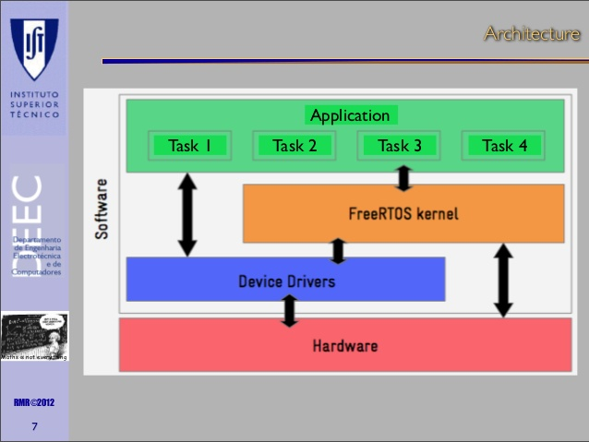
Free RTOS
FreeRTOS is solely owned, developed and maintained by Real Time Engineers Ltd. Real Time Engineers Ltd. have been working in close partnership with the world’s leading chip companies for well over a decade to provide you award winning, commercial grade, and completely free high quality software.
FreeRTOS is ideally suited to deeply embedded real-time applications that use microcontrollers or small microprocessors.
This type of application normally includes a mix of both hard and soft real-time requirements.
FreeRTOS is a real-time kernel (or real-time scheduler) on top of which embedded applications can be built to meet their hard real-time requirements.
It allows applications to be organized as a collection of independent threads of execution.
On a processor that has only one core, only a single thread can be executing at any one time.

Slide 3
FreeRTOS Features
Pre-emptive or co-operative operation
Flexible, fast and light weight task notification mechanism
Queues
Binary semaphores
Counting semaphores
Mutexes
Recursive Mutexes
Software timers
Event groups
Tick hook functions
Idle hook functions
Stack overflow checking
Trace recording
Task run-time statistics gathering

Slide 4
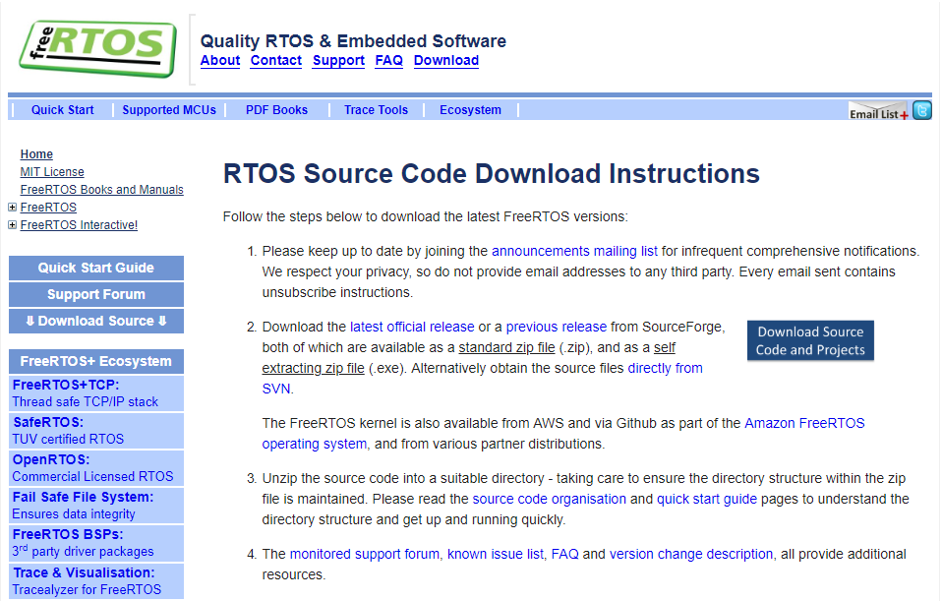
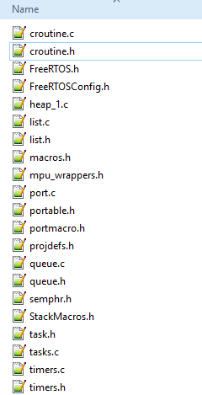
FreeRTOS source file
You can download freeRTOS for your target H.W from this link : www.freertos.org
Then you can use freeRTOS by including these source and header files into your project

Slide 5
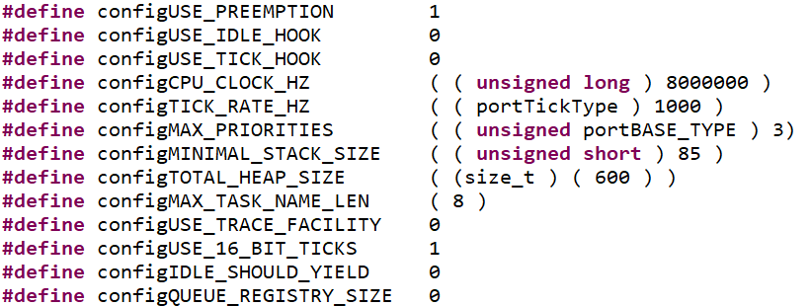
FreeRTOSConfig.h
FreeRTOS is configured by a header file called FreeRTOSConfig.h.

Slide 6
xTaskCreate() API
BaseType_t xTaskCreate(TaskFunction_t pvTaskCode,
const char * const pcName,
uint16_t usStackDepth,
void *pvParameters,
UBaseType_t uxPriority,
TaskHandle_t *pxCreatedTask );
Parameters:
pvTaskCode (pointer to the function that implements the task)
pcName (Identifying a task by a human readable name is much simpler than attempting to identify it by its handle.)
usStackDepth(Each task has its own unique stack that is allocated by the kernel to the task when the task is created. The usStackDepth value tells the kernel how large to make the stack)
*pvParameters (Task functions accept a parameter of type pointer to void ( void* ).
uxPriority (Defines the priority at which the task will execute. Priorities can be assigned from 0, which is the lowest priority, to (configMAX_PRIORITIES – 1) )
*pxCreatedTask (pxCreatedTask can be used to pass out a handle to the task being created, for example, change the task priority or delete the task. )
EX

Slide 7
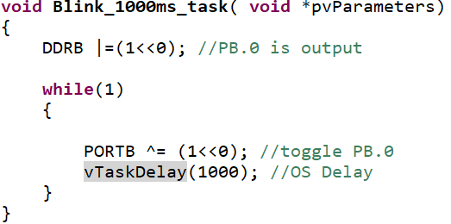
vTaskDelay() API
void vTaskDelay( TickType_t xTicksToDelay );
Parameters:
xTicksToDelay (The number of tick interrupts that the calling task will remain in the Blocked state before being transitioned back into the Ready state. )
For example, if a task called vTaskDelay( 100 ) when the tick count was 10,000, then it would immediately enter the Blocked state, and remain in the Blocked state until the tick count reached 10,100.
EX

Slide 8
vTaskStartScheduler() API
void vTaskStartScheduler( void );
Starts the FreeRTOS scheduler running.
Typically, before the scheduler has been started, main() (or a function called by main()) will be executing. After the scheduler has been started, only tasks and interrupts will ever execute.
The Idle task is created automatically when the scheduler is started.
Idle task : that is executed when none of the other tasks are ready to ran. The idle task is always set to the lowest priority
Note
will only return if there is not enough FreeRTOS heap memory available for the Idle task to be created.

Slide 9

Lab 1
Using FreeRTOS :
we have two tasks. First task blinks a LED every 200 msec and the other one blinks a LED every 1000 msec.
The two tasks run in parallel.

Slide 10
Lab 2
Using FreeRTOS create Two TASKS :
Write on LCD “I am TASK 1 “ for 1 sec.
Write on LCD “I am TASK 2 “ for 1 sec.

Slide 11
Shared Resource
Critical section :
Code segment which need to be treated indivisibly .After a section of code starts executing ,it must not be interrupted .
Process 2
Process 1
Process 3
Shared Resources :
Shared resource
(LCD)
A shared resource is a resource that can be used by more than one task .Each task should gain exclusive access to the shared resources to prevent data corruption.
Interrupt are typically disabled before critical section is executing and enabled when the critical code is finished

Slide 12
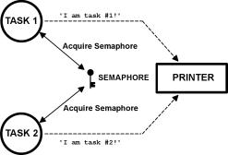
Semaphores
Imagine what would happen if two tasks were allowed to send characters to a printer at the same time. The printer would contain inter­leaved data from each task. For instance, the printout from Task 1 printing “I am Task 1!" and Task 2 printing “I am Task 2!" could result in:
I la amm T Tasask kl !2!
Semaphores are especially useful when tasks share I/O devices.
A semaphore is a kernel object that one or more threads of execution can acquire or release for the purpose of synchronization or mutual exclusion.
In this case, use a semaphore and initialize it to 1 (binary semaphore). The rule is simple: to access the printer, each task first must obtain the resource’s semaphore.

Slide 13
Semaphores
A binary semaphore is like a key that allows a task to carry out some operation or to access a resource.
There maybe several keys for each semaphore
If the task can acquire the semaphore, it can carry out the intended operation or access the resource.
Otherwise the task is blocked, if it chooses to wait for the release of the semaphore
Blocked tasks are kept in a task-waiting list.
When the semaphore is released, one task of the task waiting list gets access to the semaphore and is put into ready state
The exact implementation of the task-waiting list depends on the RTOS kernel.

Slide 14
Binary Semaphores
B
A binary semaphore is used when a resource can be used by only one task at a time.
SignalTask
A binary semaphore has either a value of:
0 (unavailable)
1 (available)
The task WaitTask has to wait until the task SignalTask releases the binary semaphore.
A binary semaphore is a shared resource
Any task can release it!
B
WaitTask

Slide 15
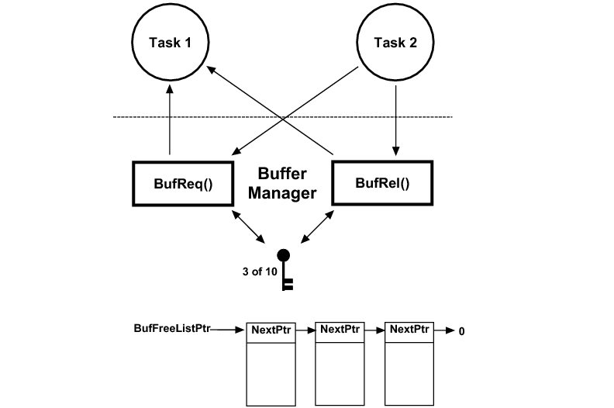
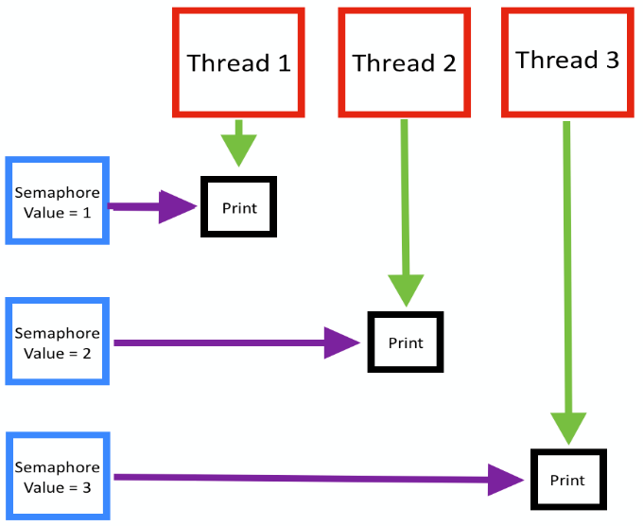
Counting Semaphores
C
A counting semaphore is used when a resource can be used by more than one task at the same time
A counting semaphore uses a count to be able to give more than one task access :
0 (unavailable)
> 0 (available)
with the semaphore count initialized to the number of free resources.
Threads then atomically increment the count when resources are added and atomically decrement the count when resources are removed.
When the semaphore count becomes zero, indicating that no more resources are present, threads trying to decrement the semaphore block wait until the count becomes greater than zero.
A counting semaphore is a shared resource
Any task can release it!

Slide 16


binary Semaphores
creation
Defining a semaphore
A semaphore is referenced by a global variable of type xSemaphoreHandle
Creating a binary semaphore
SemaphoreHandle_t xSemaphoreCreateBinary( void );
Creates a binary semaphore, and returns a handle by which the semaphore can be referenced.
Each binary semaphore requires a small amount of RAM that is used to hold the semaphore’s state.
Return Values:
NULL :The semaphore could not be created because there was insufficient heap memory available for FreeRTOS to allocate the semaphore data structure.
Any other value :The semaphore was created successfully. The returned value is a handle by which the created semaphore can be referenced.
EX

Slide 17

Counting Semaphores
creation
Defining a semaphore
Creating a counting semaphore
SemaphoreHandle_t xSemaphoreCreateCounting(UBaseType_t uxMaxCount, UBaseType_t uxInitialCount);
Creates a counting semaphore, and returns a handle by which the semaphore can be referenced.
Parameters:
uxMaxCount :The maximum count value that can be reached. When the semaphore reaches this value it can no longer be ‘given’.
uxInitialCount :The count value assigned to the semaphore when it is created.
Return Values :
NULL :Returned if the semaphore cannot be created.
Any other value :The count value assigned to the semaphore when it is created.
EX

Slide 18
xSemaphoreTake() API
xSemaphoreTake proto type
BaseType_t xSemaphoreTake( SemaphoreHandle_t xSemaphore, TickType_t xTicksToWait );
‘Takes’ (or obtains) a semaphore that has previously been created using a call to vSemaphoreCreateBinary(),
Parameters:
xSemaphore :The Semaphore being ‘Taken’. A semaphore is referenced by a variable of type SemaphoreHandle_t and must be explicitly created before being used.
xTicksToWait :The maximum amount of time the task should remain in the Blocked state to wait for the semaphore to become available, if the semaphore is not available immediately.
Return Values :
pdPASS: Returned only if the call to xSemaphoreTake() was successful in obtaining the semaphore.
pdFAIL: Returned if the call to xSemaphoreTake() did not successfully obtain the semaphore.

Slide 19
xSemaphoreGive() API
xSemaphoreGive proto type
BaseType_t xSemaphoreGive( SemaphoreHandle_t xSemaphore );
‘Gives’ (or releases) a semaphore that has previously been created using a call to vSemaphoreCreateBinary(),
Parameters:
xSemaphore :The Semaphore being ‘given’. A semaphore is referenced by a variable of type SemaphoreHandle_t and must be explicitly created before being used.
Return Values :
pdPASS: The semaphore ‘give’ operation was successful.
pdFAIL: The semaphore ‘give’ operation was not successful
Note
the task calling xSemaphoreGive() is not the semaphore holder. A task must successfully ‘take’ a semaphore before it can successfully ‘give’ it back.

Slide 20
Lab 3
We have two tasks, the communicate with each other using a binary semaphore:
First task: Scans a push button every 200msec and gives the semaphore when it's pressed.
Second Task: Waits for that semaphore and toggle a LED once when getting it.

Slide 21
Lab 4
We have two tasks, the communicate with each other using a counting semaphore:
A tactile switch which is connected to external interrupts EXT0 .when ISR takes place it gives the semaphore.
Second Task: Waits for that semaphore and write “button is pressed” on LCD.

Slide 22
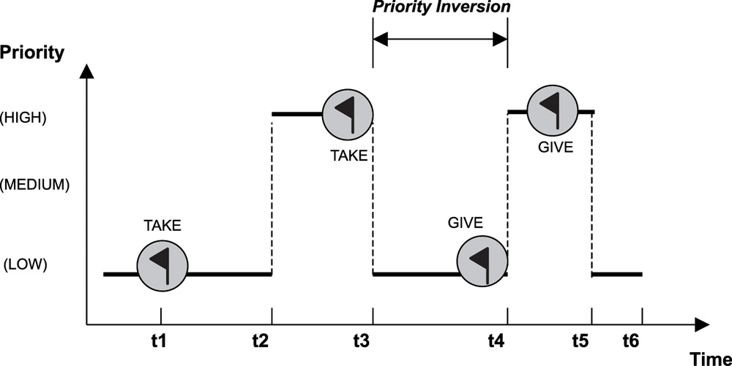
Priority Inversions
Priority inversion is a problem in real-time systems and occurs mostly when you use a real-time kernel.
In Priority Inversion, higher priority task (H) ends up waiting for middle priority task (M).
H is sharing critical section with lower priority task (L).
L is already in critical section.
Effectively, H waiting for M results in inverted priority

Slide 23
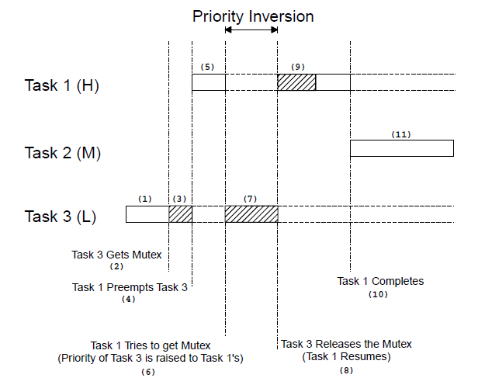
Priority Inheritance
One of the solution for this problem is Priority Inheritance..
In Priority Inheritance, when L is in critical section, L inherits priority of H at the time when H starts pending for critical section. By doing so, M doesn’t interrupt L and H doesn’t wait for M to finish.
L goes back to its old priority when L comes out of critical section.
Inheriting of priority is done temporarily .

Slide 24
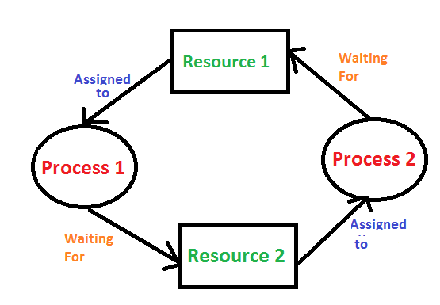
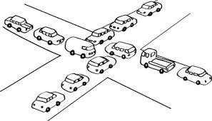
Deadlock
A deadlock , is a situation in which two tasks are each unknowingly wait­ing for resources held by the other.
Assume process 1 has exclusive access to Resource1 and process 2 has exclusive access to Resource 2 . If process 1 needs exclusive access to Resource1 and process 2 needs exclusive access to Resource2. neither task can continue. They are deadlocked.
The simplest way to avoid a deadlock is for tasks:
acquire all resources before proceeding.
acquire the resources in the same order.
release the resources in the reverse order.

Slide 25
Message passing
Message passing between processes:
Message passing is an abstract communication scheme.
Processes communicate by sending and receiving messages.
A received message can initiate new actions (like an interrupt).
Message passing can also be implemented on shared memory architectures.
msg
Mailbox
msg
P1
msg
P2

Slide 26
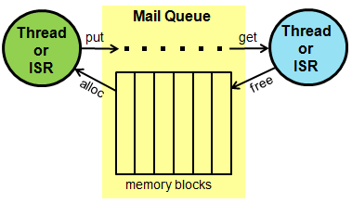
Message queue
A message queue is a buffer-like object through which tasks and ISRs send and receive messages to communicate and synchronize with data.
A message queue holds temporariliy messages from a sender until the intended receiver is ready to read them
Temporary buffering decouples sending from receiving
A message queue with a single buffer is called a mailbox

Slide 27


message queue
creation
Defining a queue
Creating a queue
xQueueHandle xQueueCreate( UBaseType_t uxQueueLength,
UBaseType_t uxItemSize );
Creates a new queue and returns a handle by which the queue can be referenced.
Parameters:
uxQueueLength:The maximum number of items that the queue being created can hold at any one time.
uxItemSize :The size, in bytes, of each data item that can be stored in the queue.
Return Values:
NULL:The queue cannot be created because there is insufficient heap memory available for FreeRTOS to allocate the queue data structures and storage area.
Any other value :The queue was created successfully. The returned value is a handle by which the created queue can be referenced.
EX

Slide 28
xQueueSend() API
BaseType_t xQueueSend( QueueHandle_t xQueue,
const void * pvItemToQueue,
TickType_t xTicksToWait );
Sends (writes) an item to the front or the back of a queue.
Parameters:
xQueue:The handle of the queue to which the data is being senT written pvItemToQueue :A pointer to the data to be copied into the queue.
xTicksToWait :The maximum amount of time the task should remain in the Blocked state to wait for space to become available on the queue.
Return Values:
pdPASS : Returned if data was successfully sent to the queue.
errQUEUE_FULL :Returned if data could not be written to the queue because the queue was already full.
EX

Slide 29

xQueueReceive () API
BaseType_t xQueueReceive( QueueHandle_t xQueue,
void *pvBuffer,
TickType_t xTicksToWait );
Receive (read) an item from a queue
Parameters:
xQueue: The handle of the queue to which the data is being received (read).
pvBuffer:A pointer to the data to be received data will be copied .
xTicksToWait :The maximum amount of time the task should remain in the Blocked state to wait for data to become available on the queue.
Return Values:
pdPASS : Returned if data was successfully read from the queue.
errQUEUE_FULL :Returned if data could not be read from the queue because the queue is already empty.
EX

Slide 30
Lab 5
We have two tasks, the communicate with each other using a Message queue:
First task : check on keypad every 50ms and send the number of pressed button in the queue.
Second task : receive a the key no from the queue and display it on LCD .

Slide 31


www.imtschool.com
ww.facebook.com/imaketechnologyschool/
This material is developed by IMTSchool for educational use only
All copyrights are reserved

